Slide 1
实用操作系统概念
张惠娟 王冬青
Ms.zhj@163.com
Wang.box@163.com

Slide 2
内容框架
概述
体系结构
进程管理
内存管理
文件管理
外设管理

Slide 3
内容
Ch2: 计算机体系结构
Ch3: 操作系统体系结构

Slide 4
Ch2：体系结构
Modern computer system structure
中断机制
I/O Structure
Storage Structure
Hardware Protection

Slide 5
Ch2：体系结构
Modern computer system structure
中断机制
I/O Structure
Storage Structure
Hardware Protection

Slide 6

Modern computer system structure
现代计算机体系结构

Slide 7
Modern computer system structure
The CPU and I/O devices can execute concurrently
CPU
  fetches a instruction and executes it.
  moves data from/to main memory to/from local buffers.
Device controller
  is in charge of a particular device type.
  has a local buffer. I/O is from the device to local buffer of controller.
  informs CPU that it has finished its operation by causing an interrupt.

Slide 8
Ch2：体系结构
Modern computer system structure
中断机制
I/O Structure
Storage Structure
Hardware Protection

Slide 9
中断机制
An operating system is interrupt driven
  Interrupt transfers control to the interrupt service routine generally, through the interrupt vector, which contains the addresses of all the service routines.
  Interrupt architecture must save the address of the interrupted instruction.
  Incoming interrupts are disabled while another interrupt is being processed to prevent a lost interrupt.
  A trap is a software-generated interrupt caused either by an error or a user request.

Slide 10
中断机制
Interrupt handling
  The operating system preserves the state of the CPU by storing registers and the program counter.
  Determines which type of interrupt has occurred:
    polling
    vectored interrupt system.
  Separate segments of code determine what action should be taken for each type of interrupt.
  Returns to the saved state or other parts of OS.

Slide 11
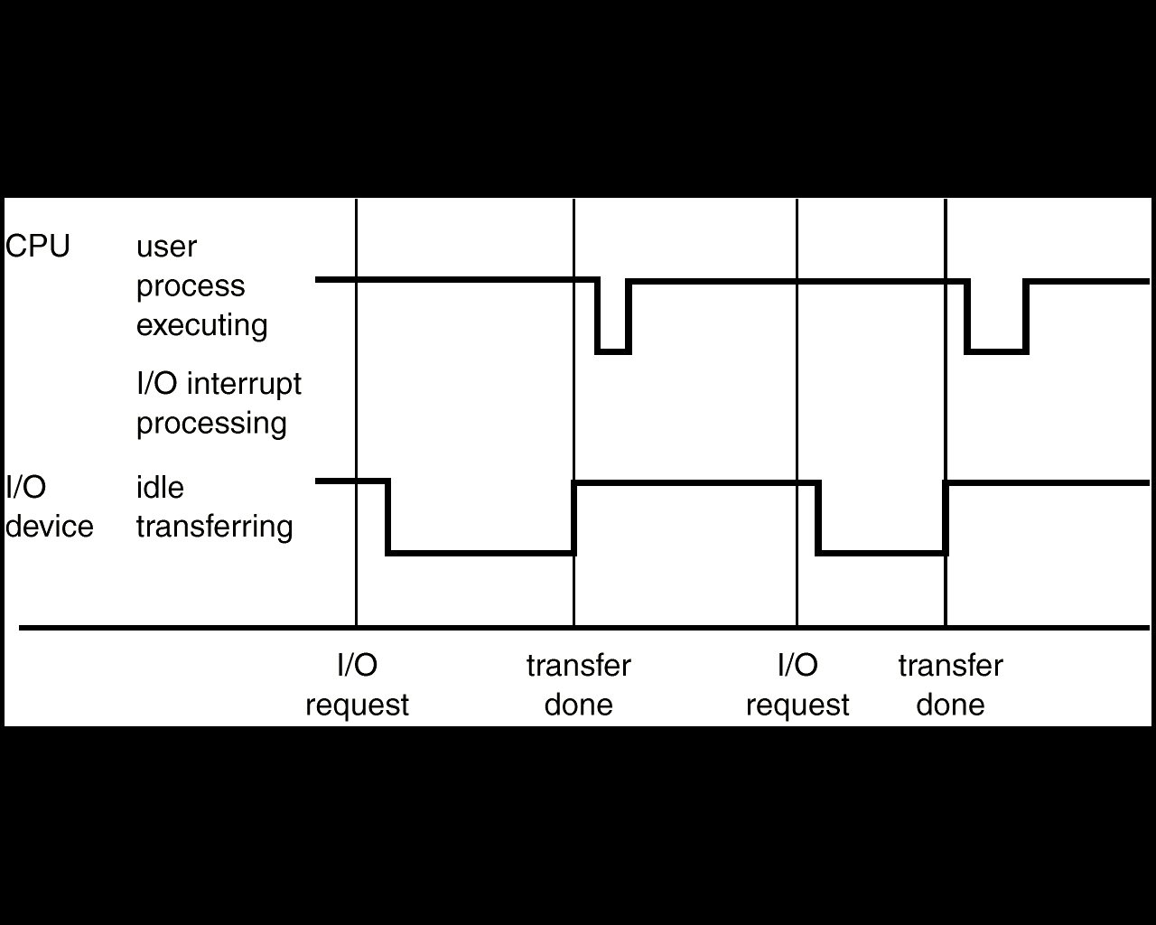
中断机制
单个进程执行输出的中断时间线路

Slide 12
Ch2：体系结构
Modern computer system structure
中断机制
I/O Structure
Storage Structure
Hardware Protection

Slide 13
I/O Structure
Two I/O methods
I/O technology

Slide 14
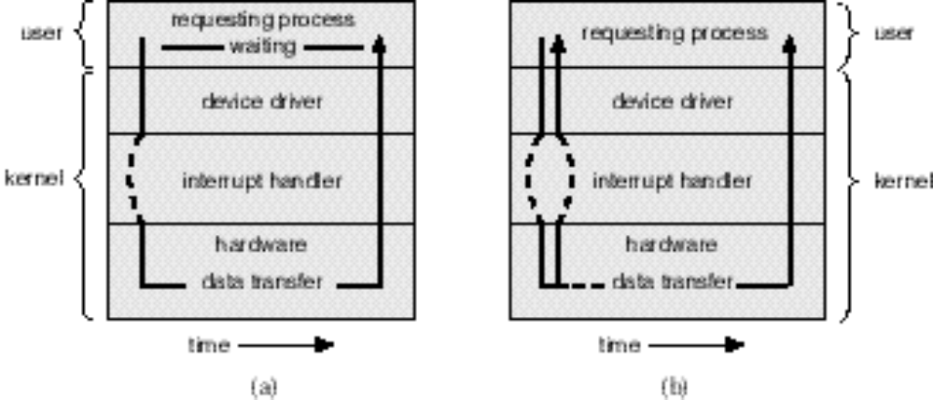
Two I/O methods
Synchronous
Asynchronous

Slide 15
Two I/O methods
Synchronous
After I/O starts, control returns to user program only upon I/O completion.
How to wait for I/O completion:
  wait instruction idles the CPU until the next interrupt
  wait loop (contention for memory access).
If the CPU always waits for I/O completion, at most one I/O request is outstanding at a time,. Thus, whenever an I/O interrupt occurs, the OS knows exactly which device is interrupting.
This approach excludes concurrent I/O operations to several devices, and also excludes the possibility of overlapping useful computation with I/O.

Slide 16
Two I/O methods
Asynchronous
After I/O starts, control returns to user program without waiting for I/O completion.
  System call – request to the operating system to allow user to wait for I/O completion.
  Device-status table contains entry for each I/O device indicating its type, address, and state.
  Operating system indexes into I/O device table to determine device status and to modify table entry to include interrupt.

Slide 17
I/O technology
Program I/O
Interrupt
DMA
Channel

Slide 18
I/O technology
Program I/O
  处理器提供I/O相关指令实现
  处理器定期轮询I/O单元的状态，直到处
  理完毕
  Problem
占用cpu时间

Slide 19
I/O technology
Interrupt
  解决PIO技术中的问题，让处理器从轮询任务中解放出来，使I/O操作和指令执行并行起来。
  具体作法
当I/O处理单元准备好与设备交互的时候，通过物理信号通知处理器，即中断处理器。

Slide 20
I/O technology
DMA
  中断的引入大大地提高了处理器处理I/O的效率，但是效率仍旧不高。
  解决方法：
直接存储器（DMA）访问
通过系统总线中一独立控制单元——DMA控制器， 自动控制成块数据在内存和I/O单元间的传送，大大提高处理I/O的效能。

Slide 21
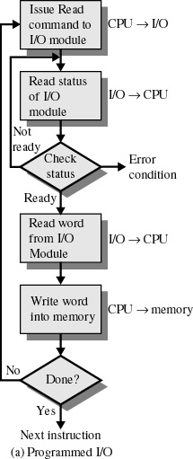
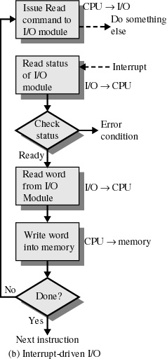
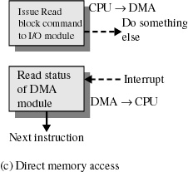
中断I/O
DMA
程序I/O

Slide 22
I/O technology
Channel
  独立于中央处理器，专门负责数据I/O传输的处理机，又称为I/O处理机
  引入通道的目的
    使CPU从I/O事务中解脱出来
    同时为了提高CPU与设备、设备与设备之间的并行度

Slide 23
Ch2：体系结构
Modern computer system structure
中断机制
I/O Structure
Storage Structure
Hardware Protection

Slide 24
Storage Structure
Main memory
Secondary storage
Storage Hierarchy
Caching

Slide 25
Storage Structure
Main memory
  only large storage media that the CPU can access directly.
  两种原因导致程序和数据不能长期驻留内存：
1. 内存大小有限；
2. 内存是易失性存储设备；
所以需要辅助存储器（secondary storage）对内存进行扩充。

Slide 26
Storage Structure
Secondary storage– extension of main memory that provides large nonvolatile storage capacity.
  Magnetic disks
  rigid metal or glass platters covered with magnetic recording material
  Disk surface is logically divided into tracks, which are subdivided into sectors.
  The disk controller determines the logical interaction between the device and the computer.

Slide 27

  Magnetic disks Structure

Slide 28
Storage Hierarchy
Storage systems organized in hierarchy.
  Speed
  Cost
  capacity
  volatility
The design of a complete memory system must balance all these factors:
  It uses only as much expensive memory as necessary,
  while providing as much inexpensive, nonvolatile memory as possible.

Slide 29

Storage-Device Hierarchy

Slide 30
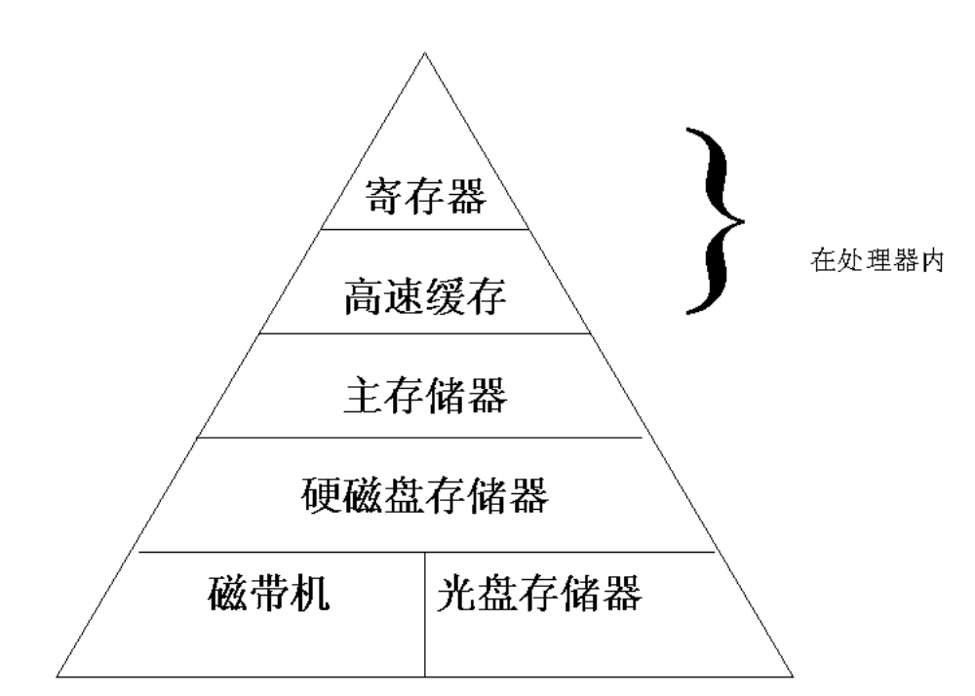

Slide 31
Caching
Caching
copying information into faster storage system; main memory can be viewed as a last cache for secondary storage.

Slide 32
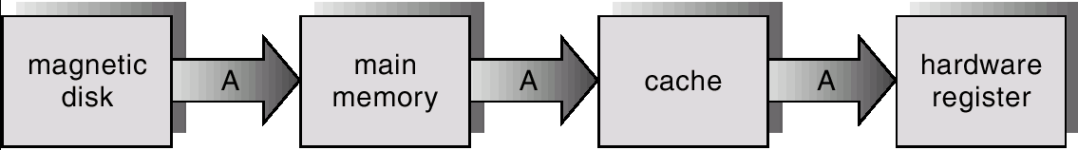
Consistency

Slide 33
Caching
缓冲三种位置
  处理器与主存储器之间
  处理器和其它外部设备之间
  设备与设备之间的通信
目的
解决部件之间速度不匹配的问题

Slide 34
Ch2：体系结构
Modern computer system structure
中断机制
I/O Structure
Storage Structure
Hardware Protection

Slide 35
Hardware Protection
Dual-Mode Operation
I/O Protection
Memory Protection
CPU Protection

Slide 36
Hardware Protection
Dual-Mode Operation
  Sharing system resources requires operating system to ensure that an incorrect program cannot cause other programs to execute incorrectly.

Slide 37
Hardware Protection
  Provide hardware support to differentiate between at least two modes of operations.
    1.User mode – execution done on behalf of a user.
    2.Monitor mode (also supervisor mode or system mode) – execution done on behalf of operating system.

Slide 38
Hardware Protection
Mode bit added to computer hardware to indicate the current mode: monitor (0) or user (1).
Interrupt/fault
monitor
user
set user mode

Slide 39
Hardware Protection
Privileged instructions can be issued only in monitor mode.
When an interrupt or fault occurs hardware switches to monitor mode.

Slide 40
Hardware Protection
I/O Protection
  All I/O instructions are privileged instructions.
  Must ensure that a user program could never gain control of the computer in monitor mode (I.e., a user program that, as part of its execution, stores a new address in the interrupt vector).

Slide 41
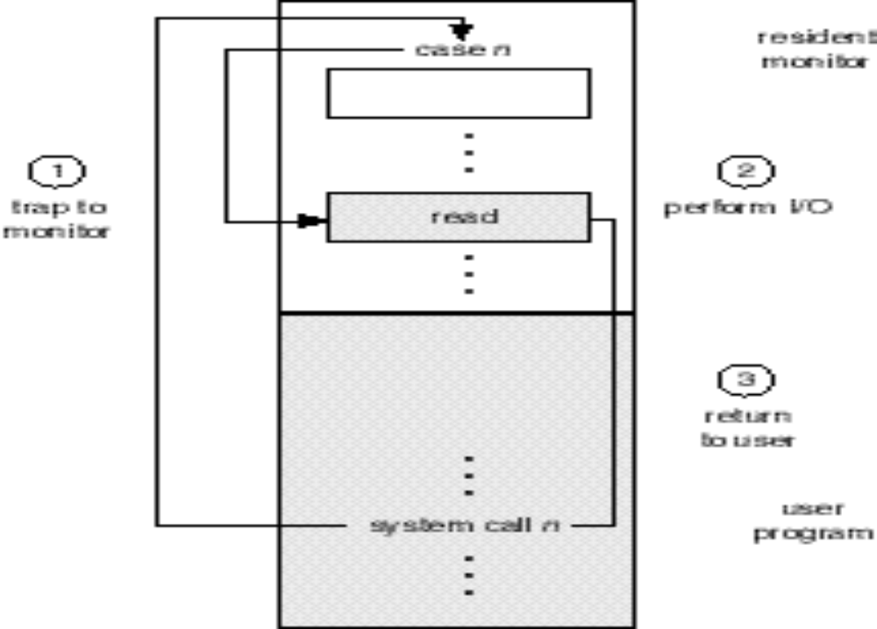
Use of A System Call to Perform I/O

Slide 42
Hardware Protection
Memory Protection
  Must provide memory protection at least for the interrupt vector and the interrupt service routines.
  In order to have memory protection, add two registers that determine the range of legal addresses a program may access:
    base register – holds the smallest legal physical memory address.
    Limit register – contains the size of the range
  Memory outside the defined range is protected.

Slide 43

Hardware Protection
Use of A Base and Limit Register

Slide 44

Hardware Protection
Hardware Address Protection
When executing in monitor mode, the operating system has unrestricted access to both monitor and user’s memory.
The load instructions for the base and limit registers are privileged instructions.

Slide 45
Hardware Protection
CPU Protection
  Timer – interrupts computer after specified period to ensure operating system maintains control.
  To use the timer to prevent a user program from running too long
    To initialize a counter with the amount of time that a program is allowed to run.
    Timer is decremented every clock tick.
    When timer reaches the value 0, an interrupt occurs.
  Timer commonly used to implement time sharing.
  Time also used to compute the current time.
  Load-timer is a privileged instruction.

Slide 46
小节
了解计算机体系结构
I/O方式
存储机制
保护机制

Slide 47
Exercises
阅读P19－P41
P41

